Slide 1
Scene Representation Model of Fools Engine
What are we even talking about?
Work in progress
Entity-Component-System
!=
Entity-Component system
Since a complete departure from using pure object oriented “Actor” model for scene representation in commercial game engines, online tutorials and conference presentations towards composition oriented (“Game Object” a.k.a. “Component-Object” a.k.a. “Entity-Component” model), data oriented (“Entity-Component-System” model) and hybrid approaches, implemented in form of a generic, game agnostic system, term “scene representation model” is going out of use, replaced by term “Entity-Component system”.
This creates a great deal of confusion, as “Entity-Component system” and “Entity-Component-System” can only be differentiated from context or in writing. Not to even mention improper use of those terms by people not knowing / understanding the difference.
Additionally, scene representations in different game engines use incompatible fundamental nomenclatures (e.g. GameObject, Pawn, Actor, Entity, Node).

Slide 2
Scene Representation Model of Fools Engine
State of the rot
Work in progress
Game engines typically include 2 interfaces for their model, one for engine build-in functionalities (rendering, physics, etc.) and systemic game features (crowds, traffic, etc.), and another one for unique, complex, high-level game features (player’s character movement, AI, etc.). Engine side often creates implicit dependencies from the get go and requires specific predefined setups to work, sometimes even as an undocumented technological debt. Game side usually comes in form of scripting (C#, Lua, BluePrints, etc.) with full access to all data of the scene, intended to be used by various types of designers without good programming principles and practices, who inevitably end up abusing it.
Single, from players perspective conceptually indivisible, element of the game (including its behavior) is implemented using multiple components and systems (and potentially game objects) with various tricky dependencies between them, but also with their own internal complexities. Games usually have unintuitive execution flows, as a result of this coupling, combined with interactions between engine and scripting interfaces. That makes reasoning about game code difficult (sometimes even literally impossible without actually running the game and testing it). Familiarizing yourself with existing game code or simply keeping up with it becomes a very big cognitive load. At the and of development process the game is literally too complex for anyone to know how it works any more. Pieces of spaghetti code are also sometimes carried over to the next project as black boxes with legacy dragons and get stacked over time like a rotting onion.

Slide 3
Scene Representation Model of Fools Engine
Facing the truth
Work in progress
Lack of intuitive grasp of a model and it’s design philosophy leads to misuse and overcomplication, even with logical understanding of it’s implementation architecture!
Fighting complexity
Embracing complexity
Games are complex. That complexity is unavoidable and has to be resolved somewhere.
If it is closed and restrictive, developers will fight it with workarounds and dirty hacks.
If it is open, it will cause inconsistencies and will result in spaghetti of dependencies.
Settling down on a simple scene representation model that supports only a narrow set of design patterns puts all responsibility and difficulty of managing that complexity on game developers.
Organization and structurization of both data and logic should be the fundamental roles of a scene representation model:
Complexity and diversity of its subject is an argument for complexity of the model!
Genericness and abstractness of the model is an argument for complexity of the model!
Simple architecture always causes problems, because it cannot be suitable for all types of features.
Putting data and logic in order properly and comprehensively is an occasion to help users create, conceptualize and optimize game code, while keeping it manageable.
Complex != Difficult; Simple != Easy;

Slide 4
Scene Representation Model of Fools Engine
Design challenges
Work in progress
Volatile
Game development process
Complex
Usability
Users of all levels of familiarity and experience
Multiple users in one project
Both technical and non-technical users
Run-Time
Performant
Hardware scalable
Stable and bug free
Encompassed Data and Logic
Complex
Divers
Densely interdependent
Dynamic
Random
Integration
Engine functionalities
Systemic game features
Unique game features

Slide 5
Scene Representation Model of Fools Engine
Goals
Work in progress
Flexible
Favors extendable and modifiable game code
Allows for multiple ways of implementing features
Organizes game code
Intuitive
Provides multiple levels of conceptualization
Has corresponding rules on them
Has predictable execution flow
Favors simple standardized designs patterns
Fully symmetric life-cycle API
Safe
Isolates game features
Has clear rules for data access and dependencies
Resolves execution order dependencies
Prevents initialization order issues
Performant
Build-in extensive parallelization (including engine-game concurrency)
Data oriented
Service oriented (pay for what you need)
Customizable
Unified (engine build-in features and game code)
Does not allow for data races

Slide 6
Scene Representation Model of Fools Engine
Solution => Hybrid
Work in progress
Hybrid
ECS
Game Object
Actor

Slide 7
Scene Representation Model of Fools Engine
Corner Stones
Work in progress
2 levels of logic: System and Behavior
Behavior deals with actor’s internal state
System deals with world’s state
Component update
Mass update of components
Explicit execution flow control
No default update calls from the engine – manual enrollment always required
Simple way of controlling execution order with 2 levels of control
1 - Simulation stages (big sync-points)
2 - Numerical priorities for Behaviors
Comprehensive feature set
Provides methods to represent every aspect of a scene, including fully independent purely visual features (foliage, particles, etc.)
Different composition/abstraction layers to choose from to implement any game feature in a suitable way
Full isolation within the same conceptual layer
Trivial parallelization of actors update and initialization
Component–component data transfer
Actor–actor data transfer
ECS Storage
Customizable optimizations
Full continuity of component storage (raw pointer iteration)
In frame pointer stability – no reallocation during component / entity creation and deferred destruction
Build-in spatial hierarchy
Fully managed by engine, hidden from user
Automated propagation of transform changes
Transform always accurate on read, but not recalculated on every change
Dictates actors update order (parent => child)
Children defined as a linked list to avoid additional heap allocations and indirections during hierarchy traversal
Entity-Component-System compliant components storage architecture
Storage structure reflects hierarchy structure (cash friendly traversal)

Slide 8
Scene Representation Model of Fools Engine
Structure overview
Work in progress
World
Actor
Mostly data, but can have logic
Dependence free
Subsection of hierarchy of entities
Dependance free
Component
Entity
Abstract container for components
Organized in a hierarchy
Examples: players character, car, NPC
Examples: head, main body, weapon
Examples: animation graph, skeletal mesh
World
Separation of indifferent domains
Scene
Specialization of storage structure
Different levels/maps in game
Examples: gameplay, particles, foliage
Root Entity
Head Entity
Entity
Entity
Entity
Head Entity
Entity
Head Entity
Entity
Entity
Entity
Entity
Entity
Actor
Actor
Actor

Slide 9
Scene Representation Model of Fools Engine
Execution and data routing
Work in progress
System
System
Behavior
Execution flow control of dependent Components
Component–component data transfer
Actor’s “internal system” – owned by Actor
Examples: animation, characterController
Uses direct component references (entity IDs)
System
Global – owned by World
2 roles:
Components update (ECS style)
Can be an opt-in or opt-out service
Examples: AI stim system, crowd sim system
Actor-actor data transfer by state injection (similarly to messages in actor model)
Actors update is an update of its behaviors
2 roles:
Can use direct component references (entity IDs)
Enrollment can be direct or using empty flag component and permanent or one-time
Systems register for update from world
Behaviors register for update from Actor
Actor
Actor
Component
Component
Component
Component
Component
Component
Component
Component
Actor
Behavior
Execution
Component
Component
Data transfer
Component
Component

Slide 10
Scene Representation Model of Fools Engine
Update Order
Work in progress
Frame Start | Pre-Physics | Physics | Post-Physics | Frame End | Post Frame
Actors
Systems
Actors
Systems
Actors
Systems
Actors
Systems
Actors
Systems
Engine
System
Parallel workload
Parallel workload
Parallel workload
System
Parallel workload
Parallel workload
System
Parallel workload
Parallel workload
System
System
Worker 1
Worker 2
Worker 3
Worker 4
Actor
Actor
Actor
Actor
Actor
Actor
Actor
Actor
Actor
Actor
Actor
Actor
Actor
Actor
Actor
Actor
Actor
Actor
Actor
Actor
Actor
Actor
Actor
Actor
Actor
Actor
Actor
Actor
Actor
Actor
Actor
Actor

Slide 11
Scene Representation Model of Fools Engine
Component
Work in progress
Basic building block
Can have data
Can have logic
Mostly utility methods for operating on that component
Can have resource references
Can restrict access to its internal state and expose getters and setters
Can perform its own update, but engine does not provide update call
Stored in global ECS storage
If inherits from another component they are considered as unrelated types
Only one instance of a given component type per one EntityID in global storage
Can have logic
Can be updated by a Behavior or a System (directly or by a call)
Cannot reference anything in the scene (“black box”)
Types
Life Cycle
Unloaded
Load
Unload
Loading
Unload
Unload
Loaded
Loading Failed
Component
FlagComponent Empty Struct
DataComponent Standard
SpacialComponent Adds transform offset
ProtectedComponent Not retrievable (engine managed)
Shutdown
Startup
Active

Slide 12
Scene Representation Model of Fools Engine
Entity
Work in progress
Scene Hierarchy
Defined by dedicated component – HierarchyNode
Used to organize storage of some components (e.g. Tags, HierarchyNode, Transforms) for cash friendly traversals
All Entities in a Gameplay World are part of one spatial hierarchy
Fully managed by engine
Children defined as linked list
Children are sorted by their EntityID
Cashes information about its hierarchy depth and children count
Entity class
Thin wrapper around World* and EntityID acting as a handle
Provides utility API for operating on components of an Entity
Provides additional handles and API to protected components responsible for carrying out functionalities of the whole model (e.g. Transform, HierarchyNode)
Abstract container for Components
Abstract container for conceptually/spatially connected components
Is represented in memory as uint32_t - EntityID
EntityID acts as a storage access key to components of an Entity
Can contain only 1 instance of each component type
Every Entity has LocalTransform, GlobalTransform, EntityName, HierarchyNode and Tags components
Unique EntityIDs
NullEntityID != 0, but constexpr
RootEntityID = 0

Slide 13
Scene Representation Model of Fools Engine
Actor
Work in progress
Update of all Actors is a multithreaded graph search of scene hierarchy
Actors are updated by engine in order defined by special hierarchy (parent => child) to ensure correctness of Transform changes propagation
Actor update is an update of all it’s Behaviors
Behavior
Updates Component instances in a single Actor
Facilitate control of data and execution flow between Components
Can have properties and transient run-time state
Update
Cannot be referenced by anything – nothing else knows about it’s existence
Actor class
Thin wrapper around Entity class
Provides utility API for operating on Behaviors, Entities and Components constituting an Actor
An Actors hierarchy is maintain in parallel to Entities hierarchy as a simplified, collapsed version
Owns and manages Behaviors
Provides Update calls to Behaviors
Abstract object
Abstract object representing single “thing” from players perspective (e.g. players character, NPC, vehicle)
Resolves execution order dependencies between Behaviors within each simulation stage using numerical priorities
Caches a dedicated list of Behaviors and their overridden Update methods enrolled for update per each simulation stage
Uses a subsection of hierarchy of Entities for storing it’s Components
Stores it’s own data in an ActorData Component in a HeadEntity

Slide 14
Scene Representation Model of Fools Engine
System
Work in progress
Roles
Execution
Actor-Actor communication using state injection (similarly to messages in actor model)
Global – owned by World
World resolves execution order dependencies between Systems within each simulation stage using numerical priorities
System registers for update during a particular frame simulation stage (can register for multiple stages)
System cannot reference other systems
System can parallelize internally their workload
Systems are executed sequentially by World
2 roles:
Operates as a service for actors (behaviors and components):
Updating multiple instances of the same Component type (ECS style)
Can be an opt-in or opt-out service
Enrollment can be direct or using FlagComponent
Enrollment can be permanent or one-time
Systems have internal locks to resolve concurrent accesses from Actors
World caches a dedicated list of Systems and their overridden Update methods enrolled for update per each simulation stage

Slide 15
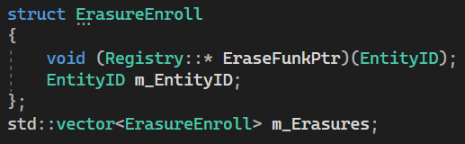
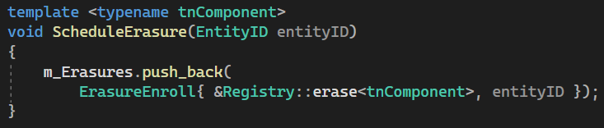
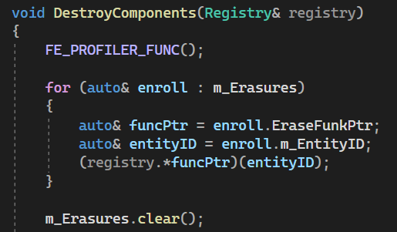
Scene Representation Model of Fools Engine
Deletions
Work in progress
Component Destruction
Pointer stability issue
Deletion of a Component (and by so also deletion of Entities and Actors) causes reshuffling of other Components of the same type in memory - invalidation of pointers and references
All deletions has to be deferred to the end of the frame to achieve in-frame pointer stability
Differing
Actors – deletion handled as deletion of underlying Entities
Behaviors and Systems are not affected by this issue, as they do not reside in ECS storage
Entities – marking with DestroyFlag component
Components – enrolling for destruction in a buffer of EntityIDs and pointers to destruction method applicable for given type of component
Component deletion is handled first, then Entities, as they may relate to the same components

Slide 16
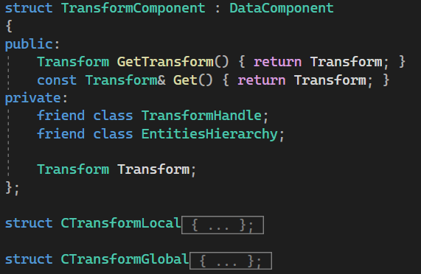
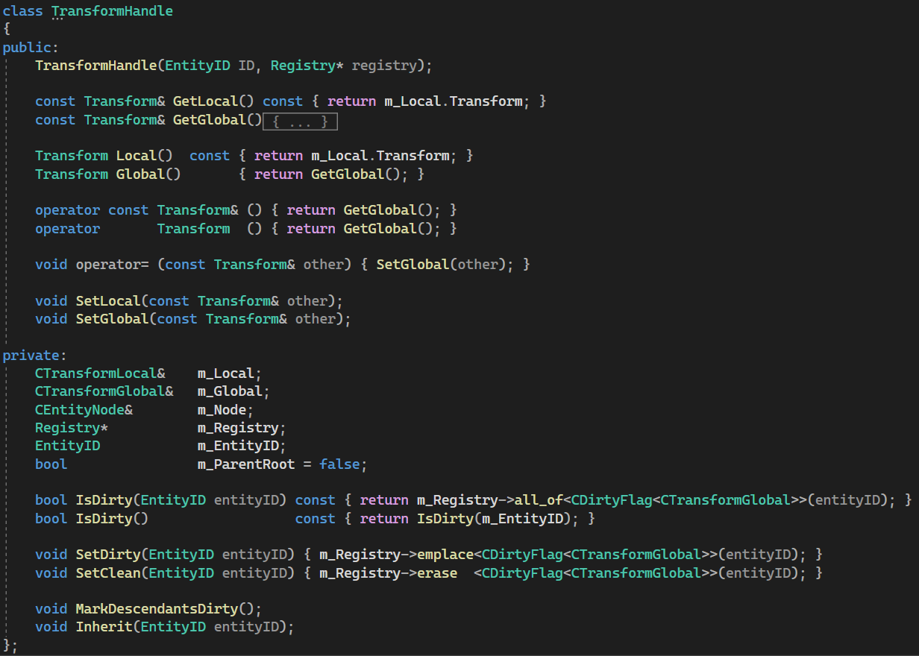
Scene Representation Model of Fools Engine
Transform
Work in progress
State Propagation
DirtyFlag component
Marks Global part as „outdated”
Two components: Global and Local
Global is recalculated upon access if necessary (if marked as „dirty”) using hierarchy chain starting from closest „clean” ancestor
Emplaced in all descendant Entities upon Global modification (Local modification implies Global modification)
Local is always accurate, Global appears as always accurate
Availability
Not accessible directly
this->Global = parent->Global + this->Local
Special handle provides safe interface to operate on either Local or Global part
Overloaded operators allowing to treat it as if it was Global aspect of the component itself
Local recalculated upon change, Global recalculated upon access if needed (has changed)

Slide 17
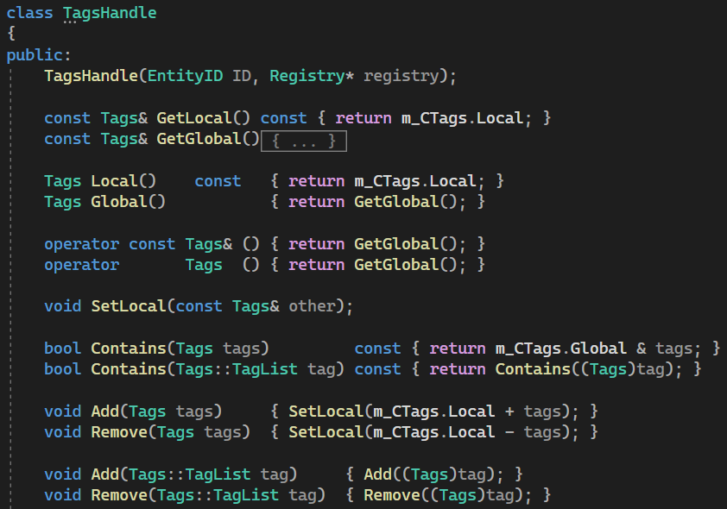
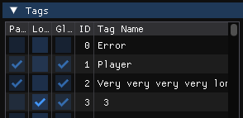
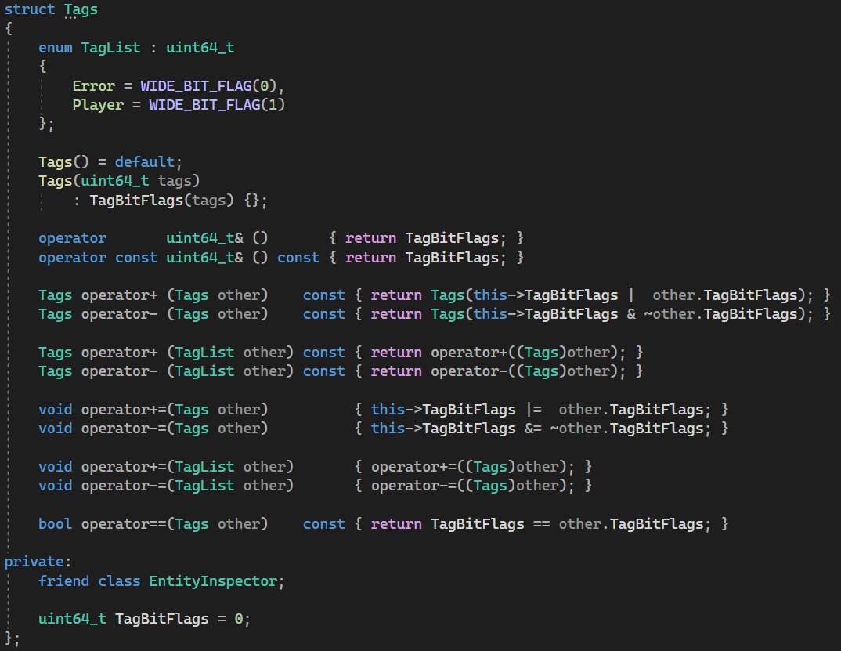
Scene Representation Model of Fools Engine
Tags
Work in progress
Tags can be inspected end easily edited in level editor
Propagation
Two parts: Global, Local (in one component)
this->Global = parent->Global + this->Local
Just uint64_t with bit flags - each bit flag represents an existence of a given tag
Tags
Meant to be used to easily recognize given Entity’s purpose and conceptual identity
Should not be used to send info down the hierarchy, unless widely used
Entity class provides utility methods, like FindTagOrigin()
Propagates down the hierarchy the same way as Transform and has similar handle, but triggers full recalculation upon each change

Slide 18
Scene Representation Model of Fools Engine
Hierarchy Storage
Work in progress
Order of Components in storage reflects logical structure of the hierarchy
Siblings are grouped next to each other
Siblings are sorted based on their EntityID (logically in linked list of Components and in storage)
Groups of siblings are grouped based on their hierarchy level
Groups of siblings on the same hierarchy level are sorted based on their parent EntityID
Storages of hierarchy related components are synchronized: EntityNode, LocalTransform, GlobalTransform, Tags
Root
Lvl 1
Lvl 2
0 | 3 | 7 | 16 | 31 | 6 | 19 | 18 | 45 | 46 | 33 | 37
Maintenance
This order is not fully guaranteed, as maintaining it at all times would be too expensive
Instead it is recreated once per frame after the simulation and before rendering
It’s purpose is to make hierarchy traversal more cash friendly
Sorting algorithm
Sorting is first performed on an array of just EntityIDs and then resulting permutation applied to component storages in linear time (sorting does not swap components unnecessarily)
Sorting is performed in 2 stages:
1: QuickSort groups each hierarchy level recursively
2: Each level is then sorted concurrently with std::sort
Continuous, amortized approach is still considered

Slide 19
Scene Representation Model of Fools Engine
Storage Customization
Work in progress
Grouping components
Limitations
Storages of component types managed by a Group lose pointer stability upon component creation
They cannot be created by Actors (concurrently running Actor’s pointers and references to it’s own components will get invalidated) – creation should happen within a global system
They cannot be accessed using CompPtr (automated cashing of component pointer within one frame) – go though registry/group using raw EntityID each time
Work in progress
Work in progress
EntityHierarchy related Components (e.g. Transforms, Tags, EntityNode) are already grouped
Protected Components cannot be included in a Group (e.g. ActorData, Tags)
Actor related Components (ActorData, ActorNode) are already grouped
Custom Storage
Limitations
Custom storage cannot be involved in a Group
Work in progress
Work in progress
Work in progress
Work in progress
ECS implementation
Current implementation of ECS storage is an external open-source library ENTT
It provides additional customization features like Groups (synchronizing orders of components) and custom component Storages (accessed through storage ID, not type)
Direct usage of those customizations can result in breaking of fundamental design corner stones of the model
Proper integration of those is not yet designed

